Slide 1
District Grading Process
2020-2021
Federal and State Compliance
Wanda Thomas, Sr. Manager
Federal & State Compliance
Student Information Systems

Slide 2
Grading Process
Learning Outcomes
How to prepare and process District Progress Reports
How to prepare and process District Report Cards
How to access important District Reports (SIS Team)
How to request access to the Office Grade Reporting role in HISD Connect

Slide 3
Grading Process – Progress Reports
Progress Report Process:
The progress report is a snapshot of teachers’ gradebooks at a specific time (progress report term period) and serves as a notification to parent/guardian of a student’s academic performance before a grade reporting (i.e., report card) period.
It is district policy to notify parent/guardian in writing if a student has received a failing grade (<70) during these grade reporting intervals.

Slide 4
Grading Process – Progress Reports
The Grade Coordinator / SIR / HS Registrar / Dean will work with Counselors and run one of the following reports 2 weeks prior to end of grading cycle:
Students Non-Schedule Period (Secondary schools)
Students Not Enrolled in a Course (Elementary schools)

Slide 5
Grading Process – Reports Reports to run before permanently storing grades
Students-Non-Scheduled Periods Report
Secondary Campuses Only
HISD Connect home page.
Select District Reports from the Reports menu.
Scroll down to Scheduling.
Select the Students-Non-Scheduled Periods report.
Use the filters to find students with no classes scheduled. Once you run the report you can Export to a CSV File.
See Grading Process Manual for step-by-step instructions.

Slide 6
Grading Process – Reports Reports to run before permanently storing grades
Students Not Enrolled in a Course
Elementary Campuses Only
HISD Connect home page.
Select District Reports from the Reports menu.
Scroll down to Scheduling.
Select the Students Not Enrolled in a Course report.
Select filters and submit.
Generate report.
See Grading Process Manual for step-by-step instructions.

Slide 7
Grading Process – Progress Reports
The Grade Coordinator will confirm with Counselors/Student Schedulers that all schedule changes are complete prior to deadline. Another addition to this verification process is that all grades are forwarded to the new teacher in the case of a schedule change to the same course.
(1 week prior to the end of grading cycle)

Slide 8
Grading Process – Long/Short Term Subs
Long Term Associate Teacher (Non-Certified) will submit grades to the Department Chairperson. The Department Chairperson will need to be added as the secondary teacher to the course. This will allow the Department Chairperson the ability to enter grades. (*The Dean of Instruction or Department Chairperson should oversee substitute teachers.)
Long Term Associate Teacher (Certified) should have a listing of grades that must be submitted to the PEIMS Coordinator. This will allow the Department Chairperson the ability to enter grades for those students as oppose to utilizing the Historical Grades. (*The Dean of Instruction or Department Chairperson should oversee substitute teachers.)
Short Term Associate Teacher The Grading Coordinator will need to collaborate with their Campus Master Scheduler for courses / classes that have a “Short Term Sub” assigned. The Department Chairperson will need to be added as the secondary teacher to the course. This will allow the Department Chairperson the ability to enter grades.
(*The Dean of Instruction or Department Chairperson should oversee substitute teachers.)

Slide 9
Grading Process – New/Transfer Students
New Students Grade Process – (Out of District / Incoming Transfer students) The Grade Coordinator/SIR/Registrar will input the current grades from the previous school. This will be done in the stored grade section in PowerSchool.
Remember, you must enter the same grade in the final grade reporting term and in the historical store code sections. This process must be done correctly for the student to meet the promotion standards at the end of the school year (elementary and middle school) or to ensure that the calculations run properly to award credit for high school courses.

Slide 10
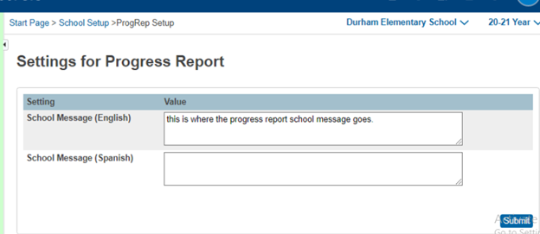
Grading Process - Continued
The Grade Coordinator will notify the campus when the cycle gradebook is open for each grading cycle via school bulletin.
(1 week prior to end of grading cycle)
Start>>setup>>School >> Progress Report Settings.
Teachers will have three (3) days to complete grades and submit them by the close of business.

Slide 11
Grading Process – Verification Reports
Elementary Reports:
Students-Not Enrolled in a Course
Teachers Scoresheet Report
Secondary Reports:
Students-Non-Scheduled Periods Report (Traditional and Block Schedule)
Teachers Scoresheet Report

Slide 12
Grading Process – Teacher Gradebook Report
The Grade Coordinator will run the Teacher Gradebook Report the morning of the 4th day after the gradebook has been locked.
This report provides an update of the teacher status (3rd day of teacher entry day). The campus administrator will be notified of teachers with incomplete grades.
(*Campus Admin should handle grades.) See Grading section of HISD School Guidelines.

Slide 13
Grading Process – Pre-K and KG Report Cards
The grading cycle for both Pre-K and Kinder is now six weeks.
The grades are based on performance observation, checklists, student products, and anecdotal records, as well as formal and informal assessments. The numerical grade level will be entered in the HISD Connect grading section.
Teacher’s will verify their gradebook. Report cards will be processed and printed from HISD Connect.
1 for Discovery – First steps
2 for Exploring – Showing progress
3 for Connecting – Ready to apply

Slide 14
Grading Process – Storing Grades
Grades will be stored at the close of Progress Report and Report Card grading cycles.
After the final grade term dates are set up, a school user runs the Permanently Stored Grades process. This process is an integral step in ensuring a snapshot of students’ grades from the teachers’ gradebooks are captured for the designated period for progress reports. These grades will be stored in the students’ historical before the progress reports are generated.
To permanently store grades:
Start Page>>Setup>> System >>Grades>>Permanently Stored Grades

Slide 15
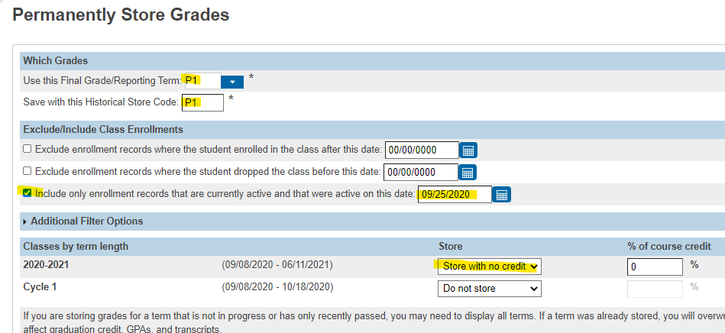
Elementary: Permanently Store Grades

Slide 16
Middle School: Permanently Store Grades

Slide 17
High School: Permanently Store Grades

Slide 18
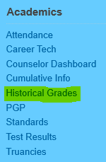
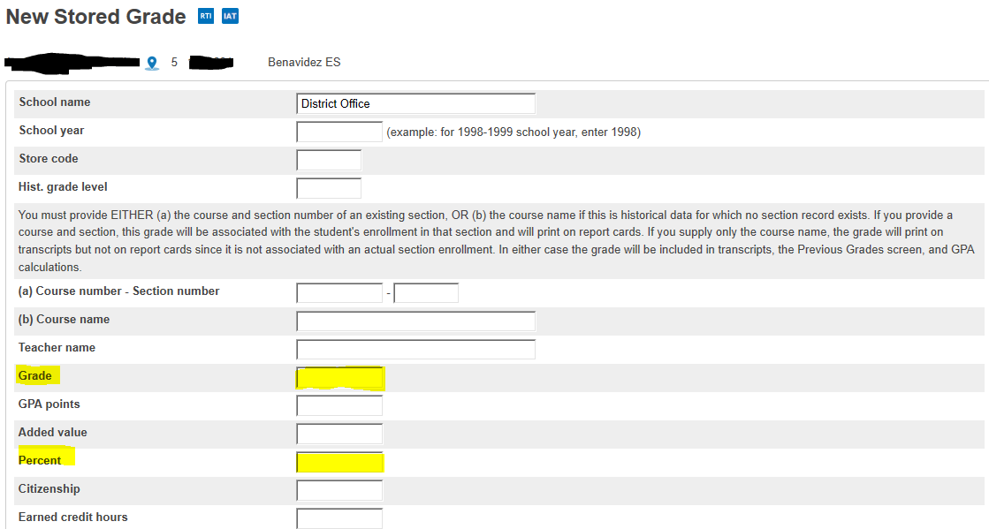
Entering A Single Grade In The Historical
Typically, this process is used when new students enroll, and they have grades from their previous school. The process is the same for elementary, middle and high schools.

Slide 19
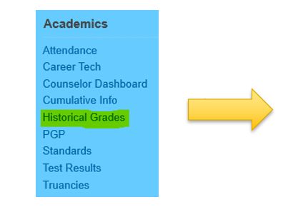
Entering Multiple Grades In The Historical

Slide 20
Entering Multiple Grades In The Historical

Slide 21
Grade Process – Printing Progress Reports
Generating/Printing Progress Reports
Step 1: Start from the Home Page.
Step 2: Select Students.
Step 3: Use the Group Functions in the lower right corner, choose Print Reports.
Step 4: Choose HISD Progress Report.
Step 5: Complete filters as needed.
Step 6: Click Submit.

Slide 22
Printing Reports – Progress Reports

Slide 23
Grade Process – Progress Reports
How to update stored grades:
AFTER grades have been permanently stored and the grading term is locked by the district admin, campuses will have the ability to manually unlock class sections in PowerTeacher Pro.
Unlocking/locking sections permits access to all (previous and current) grading terms.
This is managed at the school level and ONLY on the class section.
Please adhere to district policy when managing the locking/unlocking of school sections after grade reporting is completed.

Slide 24
Grade Process – Printing Report Cards

Slide 25
Grade Process – Printing Report Cards

Slide 26
Grade Process – Printing Report Cards

Slide 27
Grade Process – Printing Report Cards

Slide 28
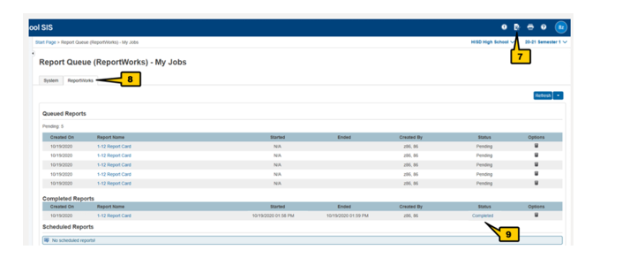
Grade Process – Printing Report Cards

Slide 29
Grade Process-Grade Changes
The only reasons for changing a student's grade after it has been recorded are:
♦ If there was an error in the computation of the student's grade; or
♦ If an error was made entering grades into the teacher’s grade book.
All such changes must be initiated by the teacher assigning the grade and must be approved in writing by the principal and the rationale for the change kept on file. A principal may not arbitrarily change a grade. All changes must be made before the end of the next grading period.
After a cycle grade has been recorded, no additional class work may be accepted to improve a student's grade. If work assigned during the cycle was not completed, the student should receive an "INC," and the grade changed when the work is completed within the required time frame.

Slide 30
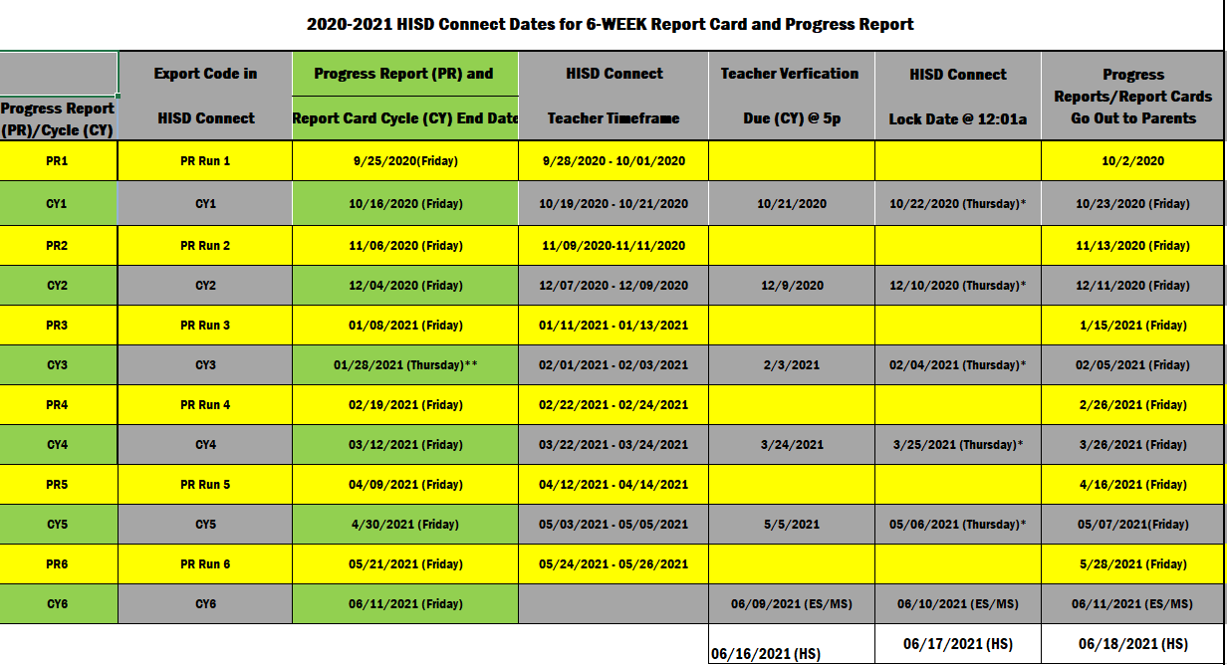
2020-2021 HISD Connect Dates for 6-Week Report Cards and Progress Reports

Slide 31
Access to Grading in HISD Connect
Complete HISD Grading Process training.
Complete SIS Security Request Form. Request access to Office Grade Reporting role.
Submit completed form to the SIS Department. Please follow all instructions on the form or access may be denied.

Slide 32
Grade Process - Contact
Name | Phone | Email
Wanda Thomas, Sr. Manager | 713-556-6775 | wthomas1@houstonisd.org
Heidi Cisneros, Sr. Compliance Analyst | 713-556-6758 | Heidi.Cisneros@houstonisd.org
Berta Garcia, Sr. Student Information Representative | 713-556-6753 | bgarcia3@houstonisd.org
Sylvia Guerrero, Sr. Student Information Representative | 713-556-6773 | Sylvia.Guerrerro@houstonisd.org
Lisa Shannon, Sr. Student Information Representative | 713-556-6766 | lshanno1@houstonisd.org
Vacancy, Sr. Student Information Representative | 713-556-6754
Latonya Smith, Sr. Compliance Analyst | 713-556-7657 | lsmith3@houstonisd.org
Marina Tejada, Sr. Student Information Representative | 713-556-6753 | mtejada@houstonisd.org
Angela Tillmon, Sr. Student Information Representative | 713-556-6762 | atillmo1@houstonisd.org
Tamika Whitmire, Sr. Student Information Representative | 713-556-6774 | twhitmir@houstonisd.org
Vacancy, Sr. Student Information Representative | 713-556-6753
Veda Winfree, Sr. Compliance Analyst | 713-556-6769 | vwinfree@houstonisd.org
Mildred Evans, Sr. Student Information Representative | 713-556-8813 | mevans7@houstonisd.org
Felicia Freeman, Sr. Student Information Representative | 713-556-6757 | ffreeman@houstonisd.org
Rosemary Fuentes, Sr. Student Information Representative | 713-556-6765 | rfuentes@houstonisd.org
Rachel Betancourt, Sr. Student Information Representative | 713-556-6753 | Rbentac2@houstonisd.org
FSC Sr. SIRS will support the campuses with the grading process.

Slide 33
Questions?

Slide 34
Thank you!

